Slide 1
Demand Forecasting and Price Optimization for Retail

Slide 2
Pricing is key to success in retail. Knowing the demand for products helps to set the right price to move stock and avoid missed sales opportunities and maximize profit.
Demand Forecasting and Price Optimization for Retail unlock the unrealized potential of existing historical transaction data to empower retailers with actionable insight into their business. Equipped with predicted price elasticity, demand, price anchoring and optimal pricing, retailers can improve profit margins and reduce time and effort allocated to managing pricing.

Slide 3
The Need for Demand Forecasting & Price Optimization for Retail

Slide 4
20%
Increase in Profit
is typical during the first 2-3 years of Price Optimization implementation
Retail Info Systems News - http://risnews.edgl.com/retail-news/What-Retailers-Don-t-Know-About-Price-Optimization-is-Killing-Them89480

Slide 5
Out-of-stock and Overstocks account for
$1.1 TRILLION
in worldwide losses each year.
Business Wire - http://www.businesswire.com/news/home/20150506005233/en/Research-Report-Retailers-Lose-1.75-Trillion-Revenue

Slide 6
Challenges Facing Manual Demand Forecasting & Pricing
Quantity of Products
Product Configurations
Strategy Consistency
Profit Margins
Product Demand
The multitude of products has increased the workload associated with price decisions.
Size options and bulk-packaging of the same product can either have a halo effect or cannibalize sales.
Staying informed of product sales performance and its relationship to pricing is key to profit potential.
Adjusting pricing at the right time and the right amount is essential to maximize profits.
Insight to a product’s popularity is imperative to realizing optimal pricing.

Slide 7
Benefits of Demand Forecasting & Price Optimization
MAXIMIZE
Profit Margins
CAPTURE
Price Elasticity
RECOGNIZE
Price Anchoring
IDENTIFY
Profit Potential
GAIN
Data Insight
SIMPLIFY
Pricing & Inventory

Slide 8
Implementing Demand Forecasting & Price Optimization for Retail

Slide 9
Challenges for Predictions
How can the insights in this large volume of data be identified and leveraged?
How can transactional sales data be converted into demand and pricing knowledge?
Which analytical approach should be taken to optimize the price?
How can demand forecasts and pricing be operationalized for scheduled performance?
How can the solution be validated properly?

Slide 10
Solution Approach
Forecast Product Demand
Minimize inventory investment and increase revenue opportunities. Reduce inventory errors and stock-outs
Make Calculated Price Changes
Intelligent price recommendations are made using price elasticity and product demand forecasts
Strategize by Category
Try different strategies based on product category/type to optimize revenue or profit
Continuous Testing
Stay current with market changes, but test prices and act on results to create a winning strategy

Slide 11
Solution Path
Demand Forecasting and Price Optimization are ongoing processes. Predictions are improved and more accurate over time as more data are added to the model.
Input Transactional Data
Quantity and quality affect the success of forecasts and recommendations.
Deploy Strategies
Adjust orders according to demand forecasts and employ recommendations within the business to realize success.
Train the Model
Identify patterns in transactional data with predictive power.
Optimize Pricing
Choose price combinations that include price anchoring to maximize overall profit.
Forecast Product Demand
Anticipate sales count at candidate price points.

Slide 12
End-to-end Data Flow
Spark on HDInsight
Forecasts demand, calculates price elasticity and gives price recommendations
Azure Data Factory
Coordinates data transfer between HDInsight and Azure Data Lake Store.
Azure Data Lake Store
Stores raw transactional data, demand forecasts, price elasticity calculations and price recommendations.
Transactional data
C
O
N
T
Power BI
O
S
Creates reports and visualizations based on the transactional data, forecasts, price elasticity and price recommendations
O
M
A
R
T

Slide 13
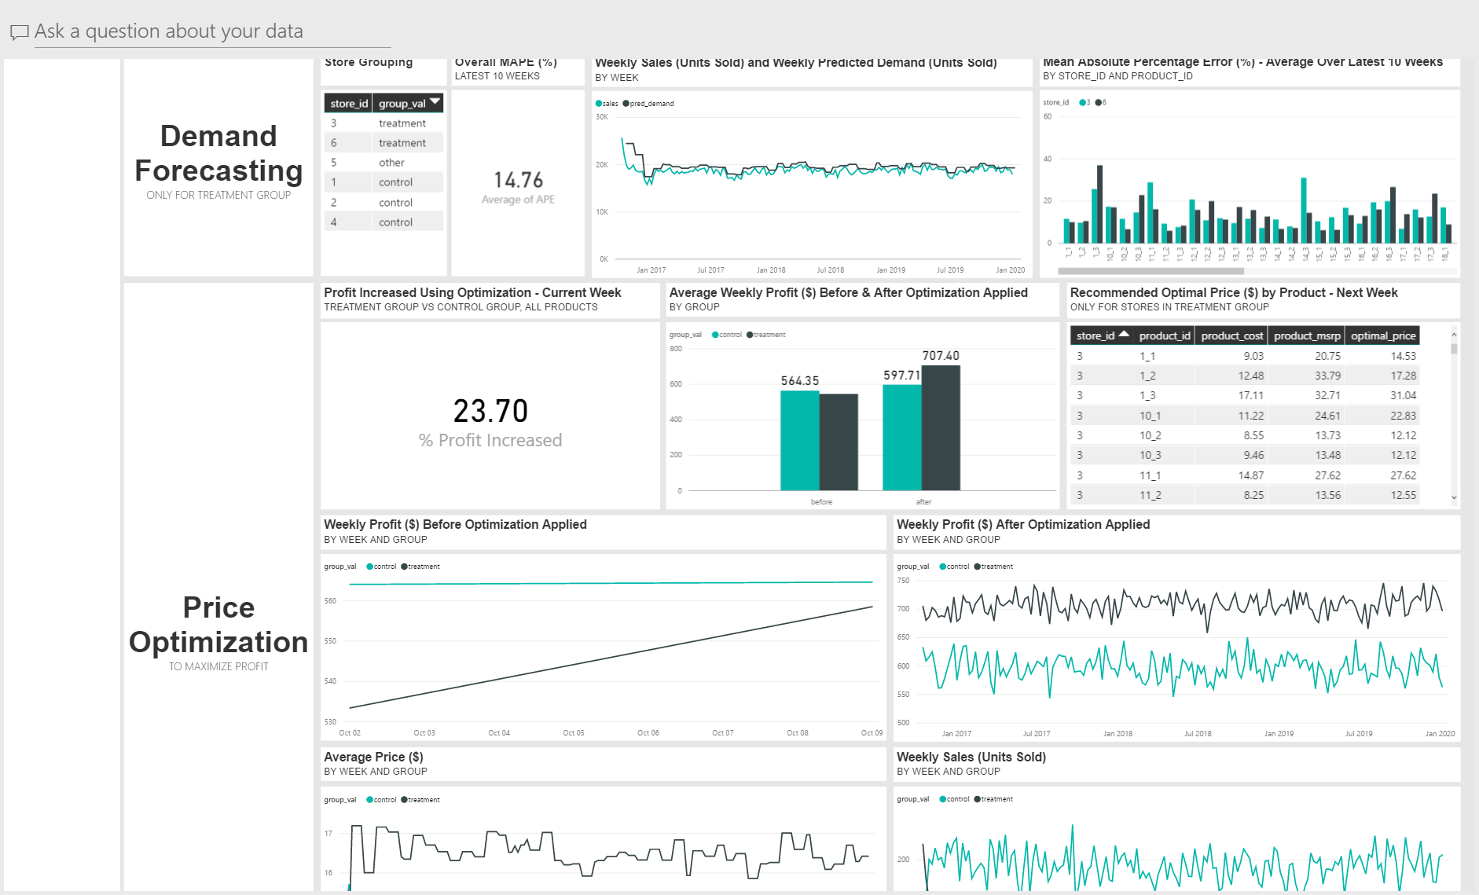
Sample Dashboard

Slide 14
Cortana Intelligence Suite

Slide 15
Cortana Intelligence Suite | Overview
Cortana Intelligence is a fully managed big data and advanced analytics suite in the cloud that transforms data into intelligent action.
Cortana Intelligence…
Allows you to collect, manage, process and store all your data that can seamlessly and cost effectively grow over time in a scalable and secure way.
Provides easy and actionable analytics powered by the cloud that allow you to predict, prescribe and automate decision making for the most demanding problems.
Enables intelligent solutions through cognitive services and agents that allow you to see, hear, interpret and understand the world around you in more contextual and natural ways.

Slide 16
Cortana Intelligence Suite | Advantages
COST
SCALABILITY
GROWTH
There are no upfront costs or COGS (Cost of Goods Sold) component costs associated. Meaning there is no need to invest in hardware, software, and/or IT maintenance. This translates into a substantial reduction in business risk.
Servers for computing and/or storage can be deployed and scaled on an as-needed basis and can be done quickly and easily. This effects the cost efficiency advantage of a cloud-based solution with a pay-for-what-is-used policy.
Features, components, and capabilities are consistently being introduced and evolved in Cortana Intelligence Suite. As such, they can easily and quickly be implemented in a cloud-based solution.

Slide 17
Cortana Intelligence Suite | Overview
Information Management
Big Data Stores
Machine Learning and Analytics
Intelligence
Data Sources
People
Data Factory
Data Lake Store
Machine Learning
Cognitive Services
Data Catalog
SQL Data
Warehouse
Data Lake Analytics
Bot Framework
Web
Apps
Event Hubs
HDInsight
Cortana
Mobile
Apps
Stream Analytics
Bots
Dashboards & Visualizations
Sensors and Devices
Power BI
Automated Systems
Data
Intelligence
Action

Slide 18
Appendix

Slide 19
Cortana Intelligence Suite | Used in this Solution
HDInsight
HDInsight allows you to easily spin up enterprise-grade open source cluster types guaranteed with the industry’s best 99.9% SLA and 24/7 support. We guarantee this SLA for the entire big data solution, not just the VM instances. HDInsight is architected for full redundancy and high availability including head node replication, data geo-replication, and built-in standby NameNode making HDInsight resilient to critical failures not addressed in standard Hadoop implementations. Azure also offers cluster monitoring and 24x7 enterprise support backed by Microsoft and Hortonworks with 37 combined committers for Hadoop core, more than all other managed cloud providers combined to support your deployment and the ability to fix and commit code back to Hadoop.

Slide 20
Cortana Intelligence Suite | Used in this Solution
Data Lake Store
With Azure Data Lake Store your organization can analyze all of its data in a single place with no artificial constraints. Your Data Lake Store can store trillions of files where a single file can be greater than a petabyte in size which is 200x larger than other cloud stores. This makes Data Lake Store ideal for storing any type of data including massive datasets like high-resolution video, genomic and seismic datasets, medical data, and data from a wide variety of industries.
Without redesigning your application or repartitioning your data at higher scale, Data Lake Store scales throughput to support any size of analytic workload. It provides massive throughput to run analytic jobs with 1,000+ concurrent executors that read and write hundreds of terabytes of data efficiently.

Slide 21
Cortana Intelligence Suite | Benefits
Cortana Intelligence Suite enables you to realize your business outcomes by providing tools to transform data into intelligent action. It transforms entire systems of production, management and governance by enabling you to reap business benefits such as:
Improve visibility and prediction accuracy
Get the right products to the right places efficiently
Offer customers exactly what they want, when they want it
Fix problems proactively before they start
Capture new business opportunities
Use Cortana Intelligence Suite to improve outcomes and solve challenges across all aspects of your business.

Slide 22
A 1% improvement in price can increase profit by 11%
Harvard Business Review - https://hbr.org/1992/09/managing-price-gaining-profit

Slide 23
“For all the moments that matter in business, there is only one point when money changes hands—the point of negotiation and purchase. That’s when the price you charge captures or fails to capture the profit you are in business to generate.”
“The Problem with Pricing”
Deloitte

